Slide 1
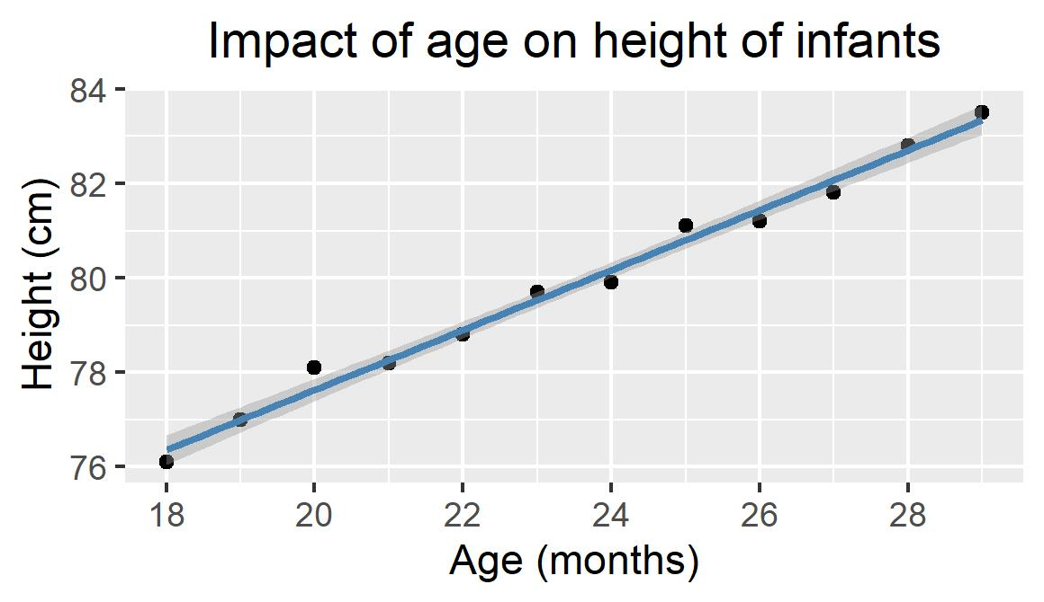
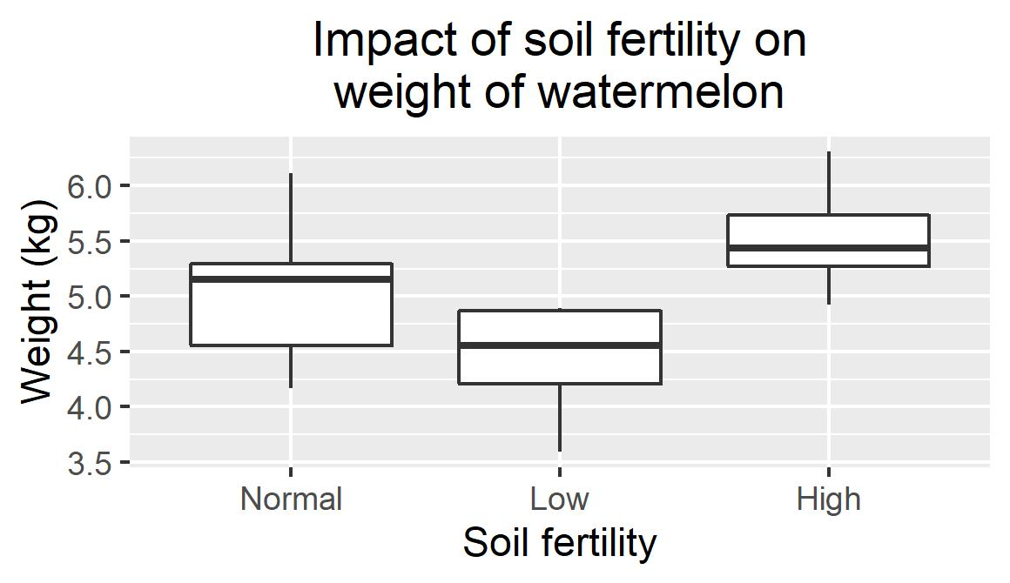
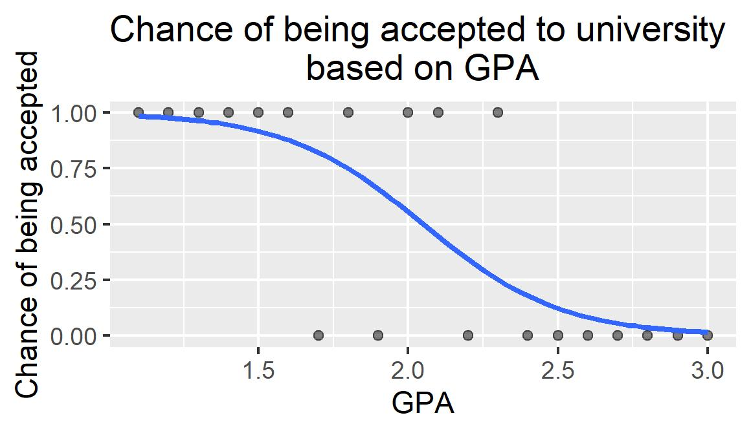
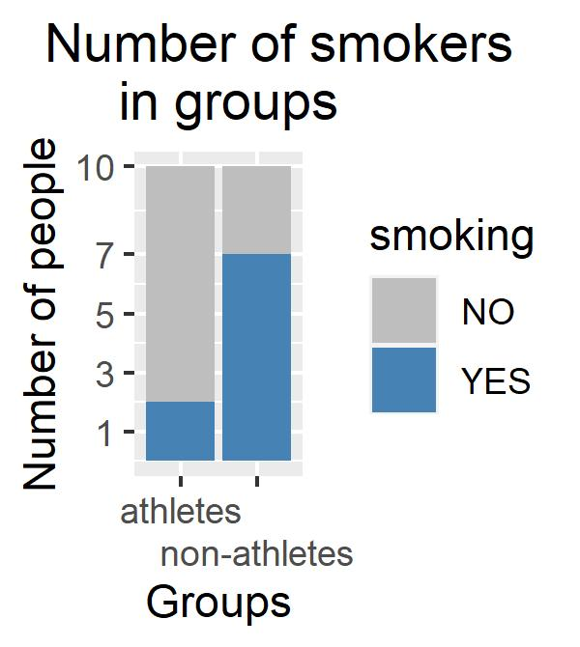
 | Independent variable You are trying to predict the dependent variable based on it. Usually on x-axis (horizontal → ).
Dependent variable What are you interested in analysing, dependent on the independent variables. Usually on y-axis (vertical → ). |  | Continuous numbers, any value, decimals, measurable (time, weight, height, volume, …) | Discrete categories, only certain values, no divisions (categories, binary data, …)
 | Continuous | Regression analysis Linear, non-linear, … ”What is the impact of one or more continuous variables on continuous dependent variable?“ | ANOVA Parametric/non-parametric (Kruskal-Wallis) ”Can we predict value of the dependent variable by knowing that the sample belongs to some discrete category?“
 | Discrete | Logistic regression Typical for binary dependent variable ”Can we predict if an event will happen based on value of a continuous variable?“ | Contingency table Χ², Fisher's exact, and other tests ”Are the occurrences distributed randomly or non-randomly through the categories?“
table
visualisation
 | YES | NO
athletes | 2 | 8
non-athletes | 7 | 3
Concept by Jeff Nekola and Barbora Winterová (Masaryk University, Czechia). Visualised in R: A language and environment for statistical computing.

